Slide 1
DragonBall Pac-Man Game
https://pacman-team-dragonball.herokuapp.com/

Slide 2
Team Members
• Jiangguo Zhang
• Sibo Wang
• Shunda Huang
• Yifan Wang
• Enze Zhong
• Can Sun
• Tingting Zhou

Slide 3
Contents
Design Decisions
Controller Implementation
UML Diagram and Design Pattern
Model Implementation
View Implementation
Game Demo

Slide 4


Design Decisions
Implementation
User Extensibility
Notes:
Thank you. Next, I’ll discuss about our design decisions for implementation of the game and increasing user extensibility.

Slide 5
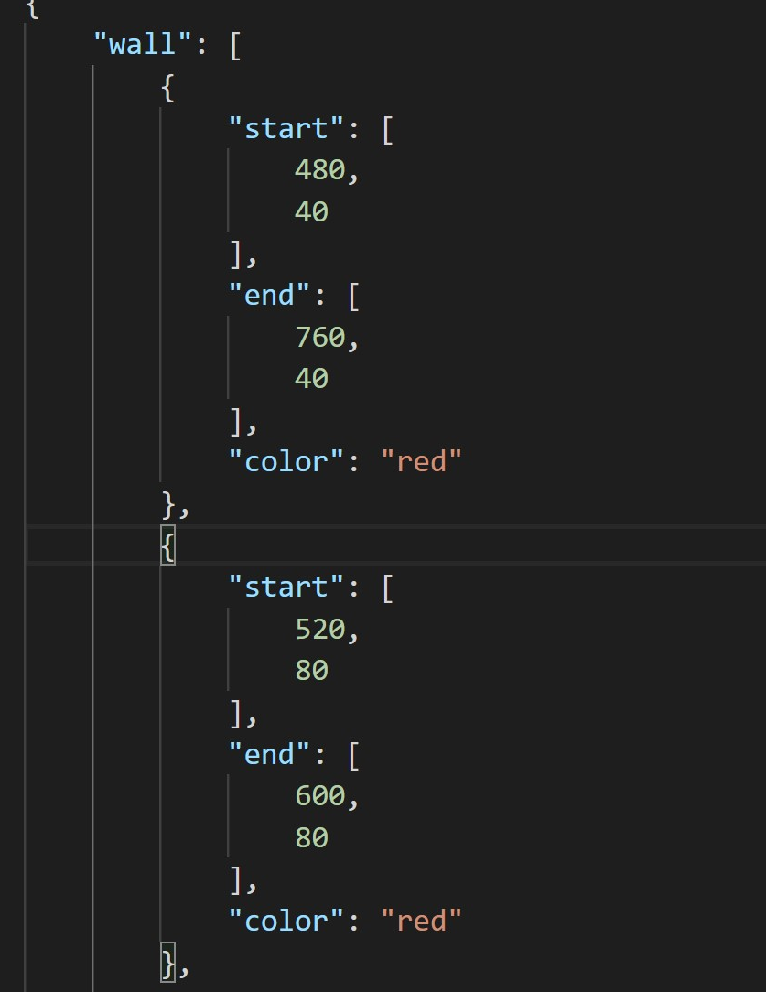





Design decisions
Use JSON file to describe the game map.
Use token to allow multiple users to play game simultaneously.
5 Kinds of Fruits: Banana, Durian, Pineapple, Watermelon and Strawberry.
Notes:
To describe the game map, we used a JSON file as representation. As you can see on the right, all walls have a start and end point, and a color to specify the wall type.

Slide 6
User extensibility
Map Editor
Draw walls, pac-dots, energizers, tunnels
Download map as JSON file
Import local JSON file and continue working on it!
Play your own map at any time
Choices
User can choose different built in maps, Dragonball or Basketball, etc.
Notes:
To make the game user extensible, we developed a map editor. In map editing mode, users can draw walls, pacdots, energizers and tunnels. Users can also download an editing map as JSON file, or import a local JSON file and work on it. Apart from editing their own maps, users can also choose from 2 built-in maps: Dragonball and Basketball

Slide 7
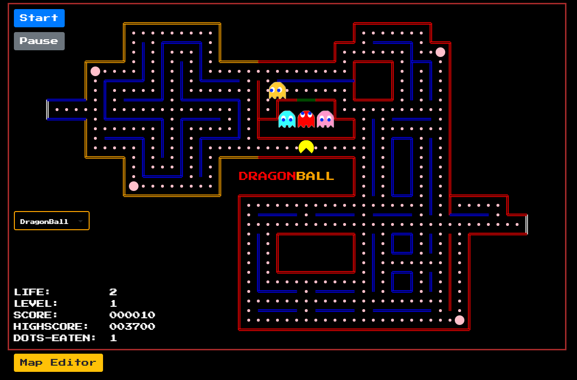
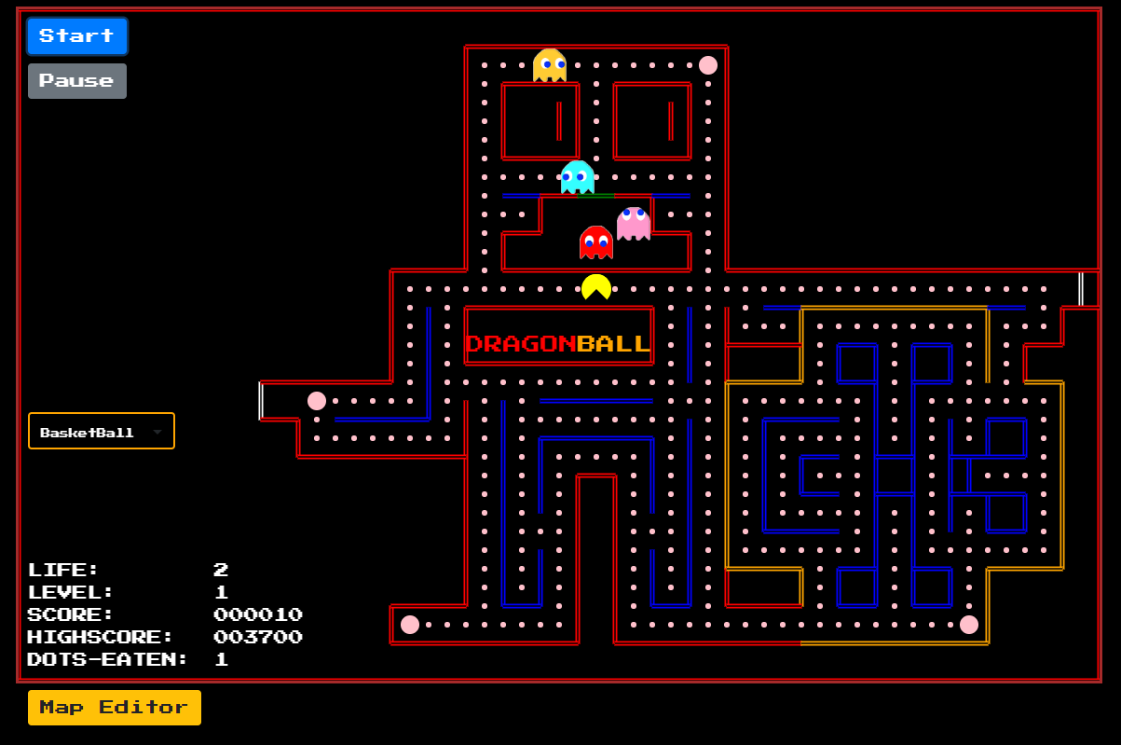
DragonBall
BasketBall

Slide 8
Controller
Requests
Get requests from front end
Mapping
Map to different Dispatch Adapters according to IDs in the response
Multiple users
Token keys are used to instantiate multiple Dispatch Adapters.
Notes:
The controller gets requests from the frontend, and maps to different dispatch adapters according to the IDs in the response. To enable multiple users, we used token keys to instantiate multiple dispatch adapters so that each user is assigned one. Next, Shunda will talk about design patterns.

Slide 9
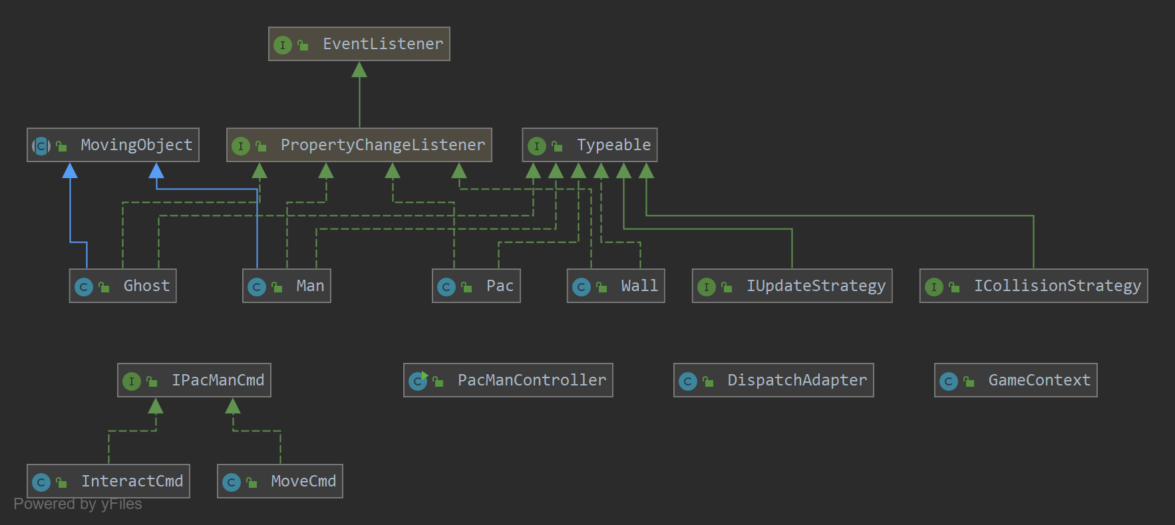
UML Diagram

Slide 10
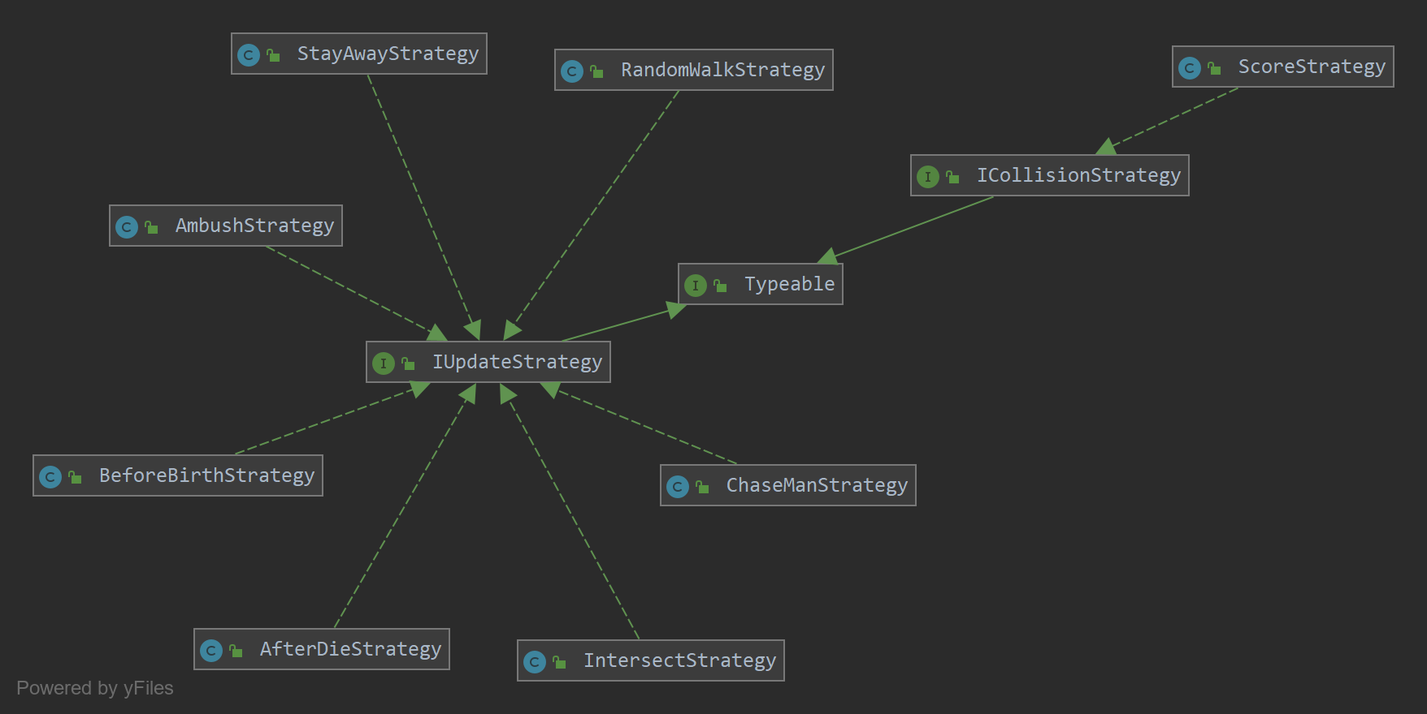
UML Diagram

Slide 11
Design Patterns
MVC Design Pattern
Strategy Design Pattern
Command Design Pattern
Singleton Design Pattern

Slide 12
MVC Design Pattern
Model
DispatchAdaptor…
View
view.js
Controller
PacManController.java

Slide 13
Strategy Design Pattern
MovingObject
Move ghost and pacman with MovingObject’s move method, it manages movement information
IUpdateStrategy
decides what the ghost should do
ICollisionStrategy
decides what should happen if pac-dots and ghost collide with pacman

Slide 14
Command
Design
Pattern
IPacManCmd
InteractCmd
tells all the object with IInteractStrategy to perform interaction
MoveCmd
tells the ghost to move according to its IUpdateStrategy

Slide 15
Singleton Design Pattern
ScoreStrategy
AfterDieStrategy
AmbushStrategy
BeforeBirthStrategy
ChaseManStrategy
IntersectStrategy
RandomWalkStrategy

Slide 16
Model Implementation
Pacman
Ghost
Fruit
Game Score and Level

Slide 17

Pacman
MovingObject
Collision detection
Binary search
Interaction
Eat energizer
3 lives

Slide 18




Ghost
Random Walk Strategy
Preprocess all the shortest paths using BFS algorithm, which will be utilized later.
Chase Man Strategy
Ambush Strategy
Intersect Strategy
Notes:
Thank you Yifan. Now we are talking about the implementation of the ghosts. Before getting to the classes, we pre-process all the shortest paths using BFS algorithm, which will be utilized later.
We have four different strategy classes for four ghosts.
Random Walk Strategy
Chase Man Strategy
Ambush Strategy
Intersect Strategy
They all implement IUpdateStrategy Interface, using strategy design pattern

Slide 19
Fruit
Counter
Update
Add
Remove
Notes:
Then, the fruit.
To implement the fruit, we maintain a counter variable. The variable will be updated everytime the game is updated. Once it becomes zero, the counter will be reset and then the fruit will be put into the map or removed from the map, depending on its previous status.

Slide 20
Game Score Game Level
Score
Highest Score
Level
Ghost velocity
Notes:
Last but not least, game score and level.
Once all the pac dots on map are eaten, the game level will be increased by 1.
Ghosts in higher level will have larger velocity and less blue status duration.
Score is increased after interaction between pacman and other elements.
The highest score is stored in the local storage of browser
Now my mate Can Sun will take it from here.

Slide 21
View Implementation
Paint according to data from backend
Pac-Man
Walk animation
Death animation
Ghosts
Walk animation
Eyes directions
Death animation
Buttons and information board
Map selection and overlay map editor
Notes:
Thank you. To make the game more similar to the original one, we have several frontend tricks.
First, we paint the objects, including walls, pacman, ghost and dots, according to the data passed from the backend.
Secondly, to make the game lively, pacman and ghosts have different animations under different states and face the correct directions.
There are buttons for pause and restart. The information board shows basic game information.
A map selection drop-down menu and an overlay map editor are also put on the interface.

Slide 22
To Meet Other Requirements
Comments
For all classes and member functions
Unit Test
Test cases for all possible states of the game
Code coverage of 93%
Host on Heroku
Host default map profiles on S3
Test to ensure it runs well online
Notes:
Here goes our demonstration.

Slide 23
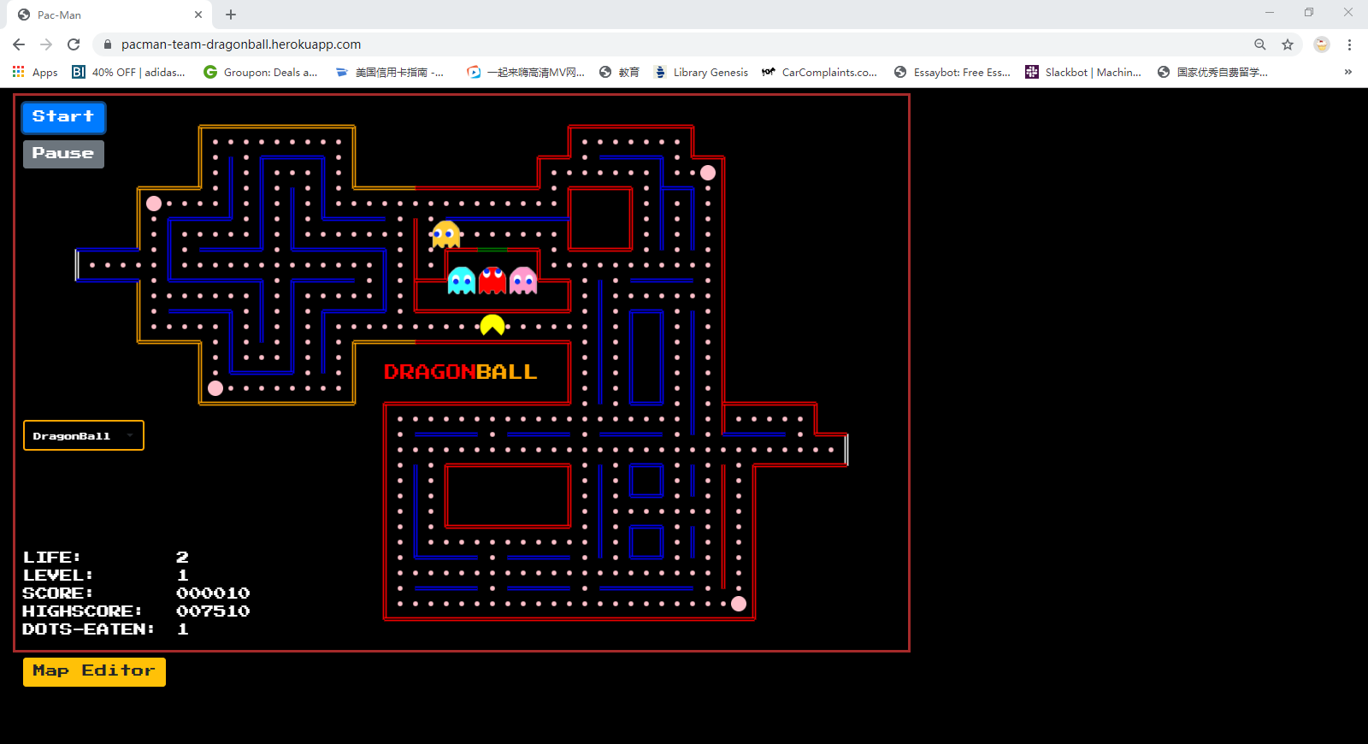
Demo

Slide 24
Thank you.

